Slide 1

Speech Synthesis And Perception With Envelope Cue
//name

Slide 2
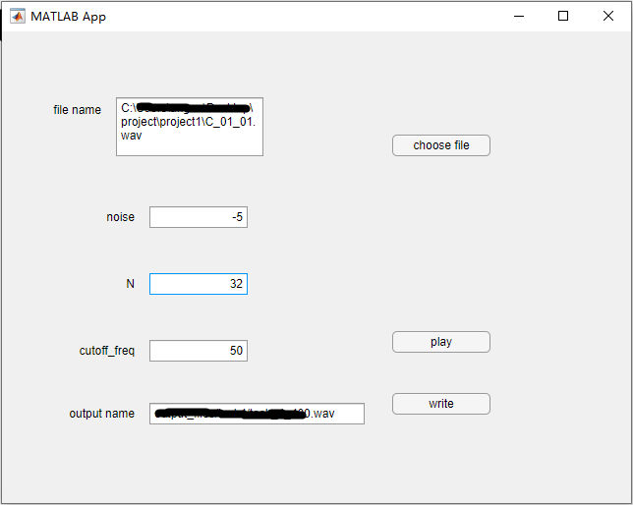
Introduce
In this project, we successfully implemented a vocoder to simulate the behavior of hearing aids and estimated the intelligibility with various parameters and input materials. Furthermore, we explored whether noise reduction can improve hearing aid users’ perceptual experience. And we managed to achieve an GUI by mlapp.
Screen Shot of the app

Slide 3
Background Knowledge
//TODO add something or delete this page

Slide 4
Learnings
Our study showed that the number of frequency channels dominates the performance of the vocoder, and CIs are sensitive to the tonal features of inputs. Additionally, the noise reduction approach improves the intelligibility of the performance in a noisy environment.

Slide 5
Critical Thinking
First we try to manually split up each sections for different Ns, but we found that to hard when N is relatively large. So we change the way of simulations and use a vectorized one, which really increase our productivity, and further more, gives us an interface which can be linked to the GUI.

Slide 6
Results
//TODO add Outside links or something else

Slide 7
Team effort
//TODO finish this

